Slide 1
QUANTUM COMPUTUING
Sivani S Iyer-RA2211003010865
Arushi Singh-RA2211003010847

Slide 2
AGENDA
Introduction​
Application
​Implementation
​Summary​

Slide 3
QUANTUM COMPUTERS
Quantum computers are advanced computing devices that utilize quantum bits (qubits) instead of classical bits. These qubits can exist in superposition, representing multiple states simultaneously, and are often entangled, allowing for more efficient calculations. Quantum computers have the potential to solve complex problems at speeds that classical computers cannot match. However, they are still in the early stages of development, facing technical challenges before becoming widely practical. They hold promise for revolutionizing fields like cryptography, optimization, and quantum simulations.

Slide 4
APPLICATION OF QUANTUM COMPUTER

Slide 5
from qiskit import QuantumCircuit, transpile, execute, Aer # Create a quantum circuit quantum_circuit = QuantumCircuit(2) # Apply quantum gates quantum_circuit.h(0) # Hadamard gate on qubit 0 quantum_circuit.cx(0, 1) # CNOT gate on qubits 0 and 1 # Compile the circuit transpiled_circuit = transpile(quantum_circuit, backend=Aer.get_backend('qasm_simulator')) # Simulate the quantum circuit simulator = Aer.get_backend('qasm_simulator') job = execute(transpiled_circuit, simulator, shots=1024) result = job.result() # Display measurement results counts = result.get_counts(quantum_circuit) print(counts)
CREATE A CODE FOR QUANTUMCOMPUTING

Slide 6
Adding two numbers A quantum computer would add two numbers in a fundamentally different way than a classical computer. A classical computer uses bits, which can be in one of two states: 0 or 1. A quantum computer, on the other hand, uses qubits, which can be in a superposition of states, meaning that they can be in multiple states simultaneously.Quantum computers can perform certain operations much faster than classical COMPUTER.

Slide 7
ALGORITHMS
Shor's algorithm, which can factorize large integers exponentially faster than the best known classical algorithms. This has implications for the security of public key cryptography, which is used to secure internet communications and electronic transactions.
Grover's algorithm, which can search an unsorted database quadratically faster than a classical algorithm. This has implications for data mining, machine learning, and other applications that involve searching large amounts of data.
Quantum simulation, which can simulate the behavior of quantum systems with much greater accuracy and efficiency than classical methods. This has implications for the design of new materials, drugs, and other chemical compounds.However, it's important to note that quantum computers are still in the early stages of development and it's not clear yet what kind of problems they will be able to solve. Additionally, quantum computers are very sensitive to their environment and require specialized conditions to function properly.

Slide 8
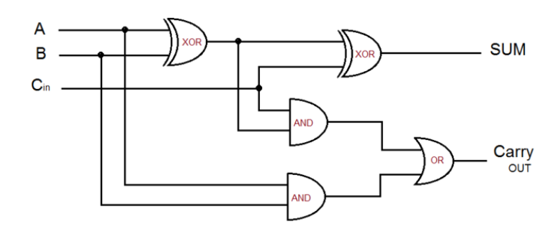
IMPLEMENTATION
Full Adder
A Full Adder is a logic circuit used by classical computers to implement addition on up to 3 bits.

Slide 9
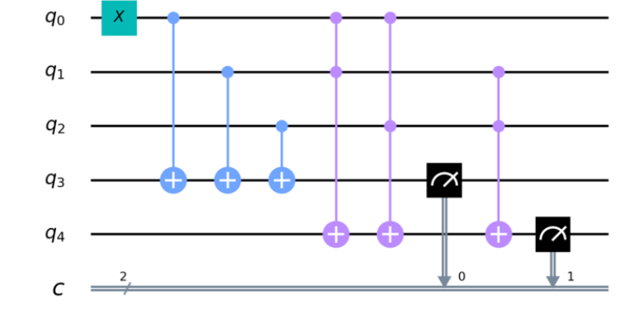

Slide 10
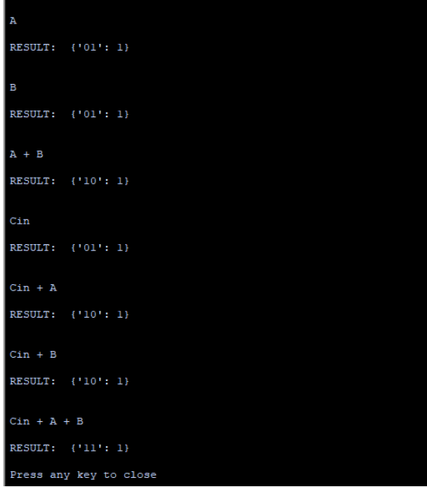
OUTPUT

Slide 11
SUMMARY
In quantum computing, adding two numbers involves representing those numbers as quantum states and performing quantum operations to achieve the sum. The quantum equivalent of adding two numbers, such as a and b, uses quantum gates to create a superposition of all possible states of a and b. Quantum addition algorithms, like the Quantum Fourier Transform and Quantum Carry Ripple Adder, are then applied to compute the sum. Unlike classical computing, quantum addition can process multiple combinations of numbers simultaneously, potentially offering exponential speedup for certain problems. However, building practical quantum adders and addressing error correction challenges are ongoing areas of research in quantum computing.

Slide 12
THANK YOU

